Slide 1

Sarcasm detection
Nihar Patel (160110116033)
Pooja Suthar (160110116051)
Guided by: Dr. Miral Patel

Slide 2
Definition
There has been a lot of increase in opinionated textual data in social media.
Large product-based companies use sentiment analysis to analyse these opinionated text.
Now, sarcastic texts have the opposite meaning of what you actually write.
Sarcasm Detection is one of the major problems faced in sentiment analysis.
Our project aims to detect this “sarcasm” in the text.

Slide 3
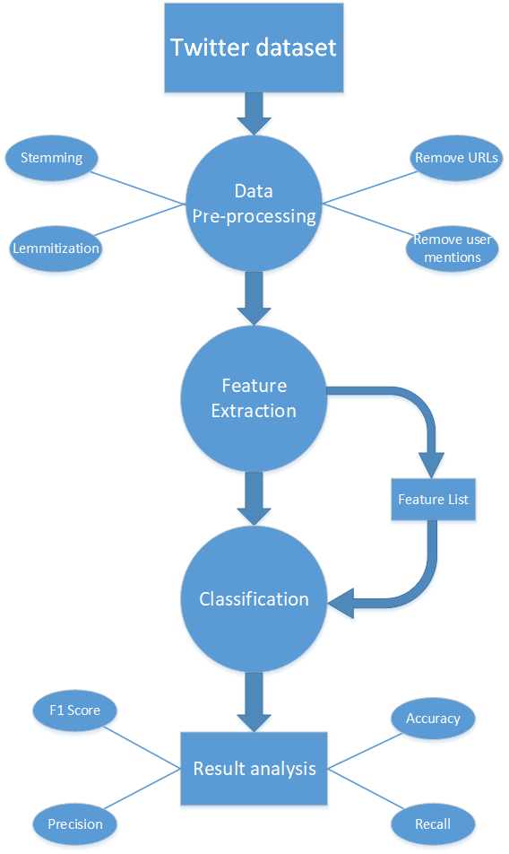


Basic phases/modules

Slide 4
Data pre-processing
Following are the data pre-processing steps suggested by the research papers:
Tokenization: Sentence and phrases are tokenized into words.^{[2]}
Stop word removal: Remove stop words(a, an, the, etc)^{[2]}
Stemming and Lemmatization: Converting words into their root words^{[2]}
P-O-S tagging: Parts of speech tagging(noun, verb, adjective, etc)^{[2]}
Removing urls^{[1]}
Removing hashtags^{[1]}
Removing user mentions(@---)^{[1]}

Slide 5
Feature extraction
All the features described in the research papers can be broadly classified in following 4 categories:
Text-expression based features (exclamations, interjections)
Emotion-based features (bigrams, Sentiment score)
Familiarity-based features (repeating letters)
Contrast-based features (Polarity-flip)
Sometimes single features exceed performance of multiple features (eg. Negative word count in SVM)^{[3]}.
Also, contrast-based features give consistent results for all classifiers.^{[2]}
So, we need to use multiple features with different classifiers which gives the best result.

Slide 6
FEATURE LIST
User mention count
Punctuation (exclamation, ellipses,question marks)
Emoji sentiment
Unigrams,bigrams,trigrams
Hashtag polarity
Polarity flip(positive words and negative words)
Intensifier count
Interjection count

Slide 7
Classifiers
Following are the classifiers discussed in the research papers:
Naïve Bayes
Support Vector Machine (SVM)
SVM and Neural Networks are found to give generally better results.^{[1]}
No research paper provides proper comparision

Slide 8
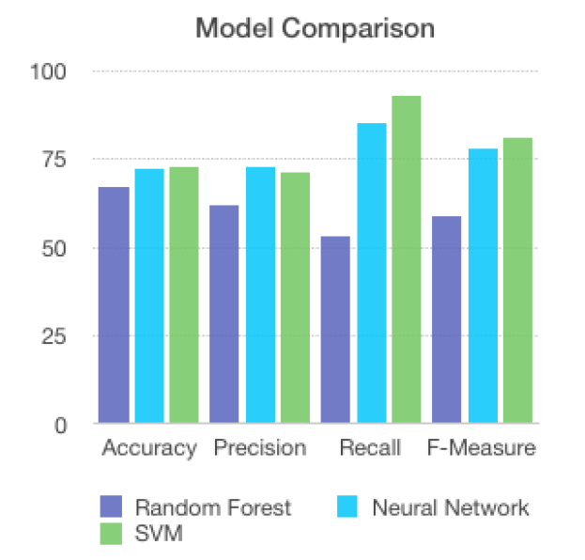

Classifiers Comparison

Slide 9
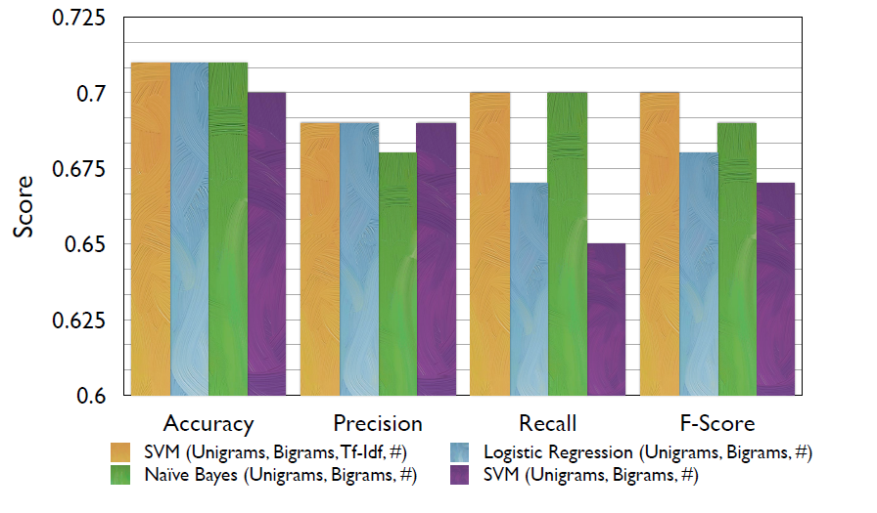

Slide 10
Result analysis
The following are the metrics generally used to analyse the performance of the model:
Accuracy
F1 score
Precision
Recall
Using these we can compare our module’s performance with the existing results in the published research papers.

Slide 11
Deployment
Flask micro web-framework to deploy the machine learning model.
Light-weight framework, good for minimal web applications.
Process:
Save the machine learning model as a pickle file.
Flask can process http requests using pickle object.

Slide 12
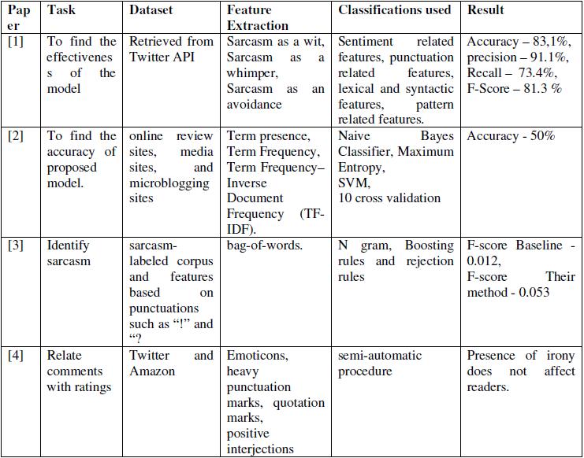
Research paper comparison

Slide 13
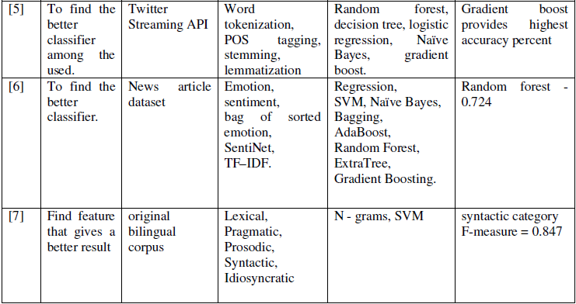

Slide 14
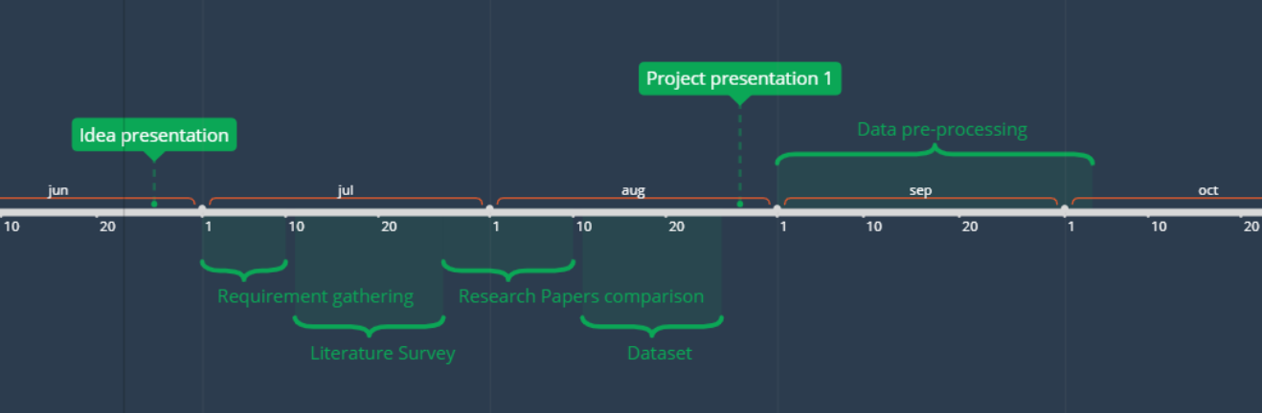
timeline

Slide 15
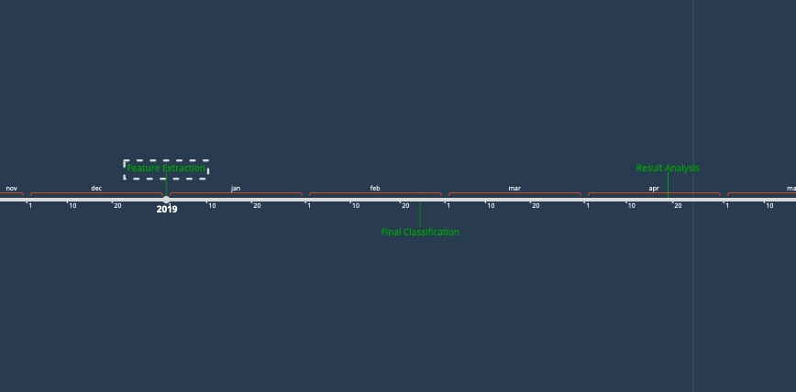
TIMELINE

Slide 16
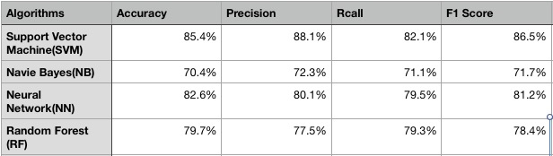
RESULT

Slide 17

RESULT COMPARISON

Slide 18
References
[1] Lohita Sivaprakasam, Aarthe Jayaprakash “A Study on Sarcasm Detection Algorithms” in International Journal of Engineering Technology Science and Research, Volume 4, Issue 9, September 2017.
[2] Dr. Vadivu G, Sindhu Chandra Sekharan “A Comprehensive Study on Sarcasm Detection Techniques in Sentiment Analysis” in ResearchGate publication 325843750, June 2018.
[3] Mikhail Khodak, Nikunj Saunshi, Kiran Vodrahalli “A Large Self-Annotated Corpus for Sarcasm” , Princeton University, October 2017.
[4] Erik Cambria, Roger Zimmermann, Rada Mihalcea “ Contextual Sarcasm Detection in online discussion formus”, National University of Singapore, May 2018.
[5] Aditya Joshi, Pushpak Bhattacharyya, Mark Carman “ Automatic Sarcasm Detection: A survey”, IIT Bombay, 2017.
[6] Meishan Zhang, Yue Zhang, Guohong Fu “Sarcasm Detection Using Deep Neural Network”, Singapore University of Technology.

Slide 19
[7] Pushpak Bhattacharyya “Sarcasm Detection: A Computational and Cognitive Study”, IIT Patna, Jan 2018.
[8] Ravinder Ahuja, Shantanu Bansal, Shuvam Prakash, Alish Banga “Comparative Study on Different Sarcasm Detection Algorithms based on Behavioural Approach”, International Conference on Advances in Computing and Communication(ICACC-2018).
[9] Ashwin Bhatt, Yash Bhalgat, Kalpesh Patil, Navjot Singh “Sarcasm Detection in tweets”, May 2017.
[10] Samuel Albanie, “Sarcasm detection: bolstering lexical features with contextual clues”, University of Dublin, Trinity College, September 2013.

Slide 20
Thank you

